Slide 1
Histogram of Oriented Gradient

Slide 2
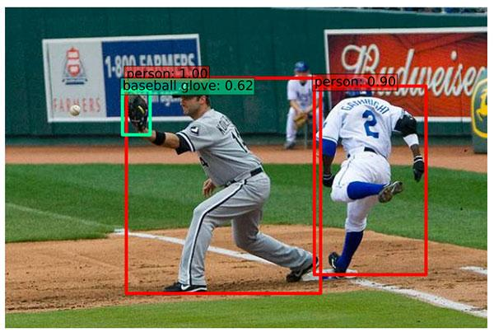
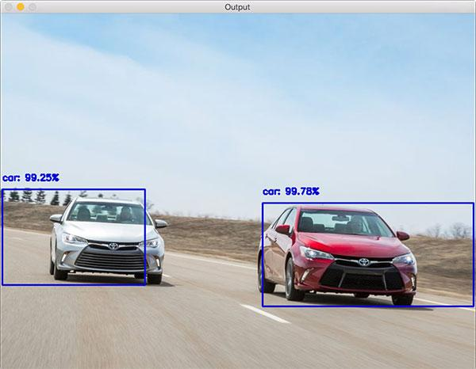
Object Detection With OpenCV
One of the important fields of Artificial Intelligence is Computer Vision. Computer Vision is the science of computers and software systems that can recognize and understand images and scenes

Slide 3

Computer Vision
Computer Vision is also composed of various aspects such as
Object Detection
Image Generation
Image Super resolution
image super-resolution

Slide 4
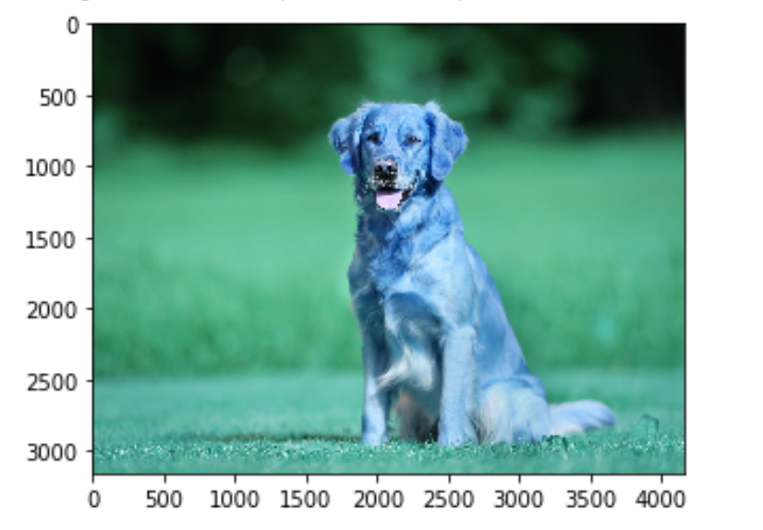
OpenCV Loading Image
import cv2
# Load the classifier
# classifier = joblib.load("digits_cls.pkl")
image_path = '/content/drive/My Drive/vijaya_bank/dog.jpg'
# Read the input image
im = cv2.imread(image_path)
# show the image
import matplotlib.pyplot as plt
plt.figure(figsize=(5,5))
plt.imshow(im)

Slide 5
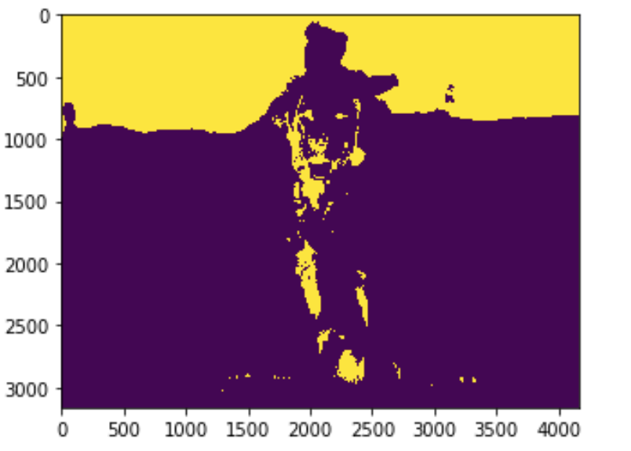
Image Preprocessing
# Convert the image to Gray Scale
im_gray = cv2.cvtColor(im, cv2.COLOR_BGR2GRAY)
im_gray = cv2.GaussianBlur(im_gray, (5, 5), 0)
# Threshold the image
ret, im_th = cv2.threshold(im_gray, 90, 255, cv2.THRESH_BINARY_INV)
plt.imshow(im_th)

Slide 6
Feature Descriptor
A feature descriptor is a representation of an image or an image patch that simplifies the image by extracting useful information and throwing away extraneous information
Typically, a feature descriptor converts an image of size width x height x 3 (channels ) to a feature vector / array of length n. In the case of the HOG feature descriptor, the input image is of size 64 x 128 x 3 and the output feature vector is of length 3780.

Slide 7
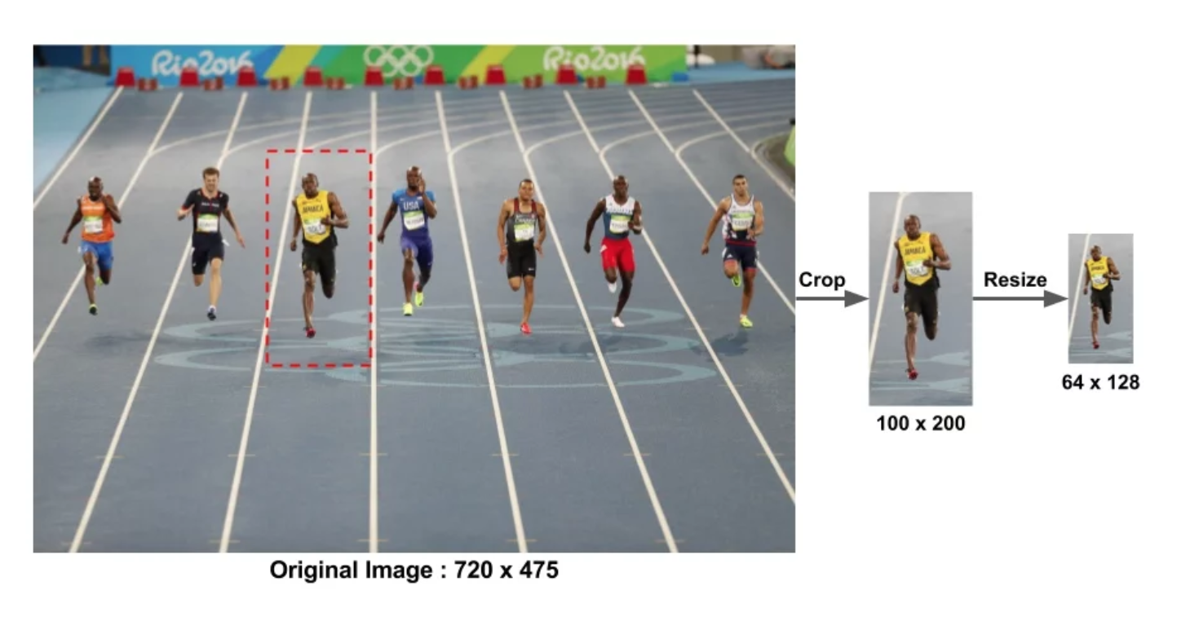
Preprocessing
This patch is cropped out of an image and resized to 64×128. Now we are ready to calculate the HOG descriptor for this image patch

Slide 8
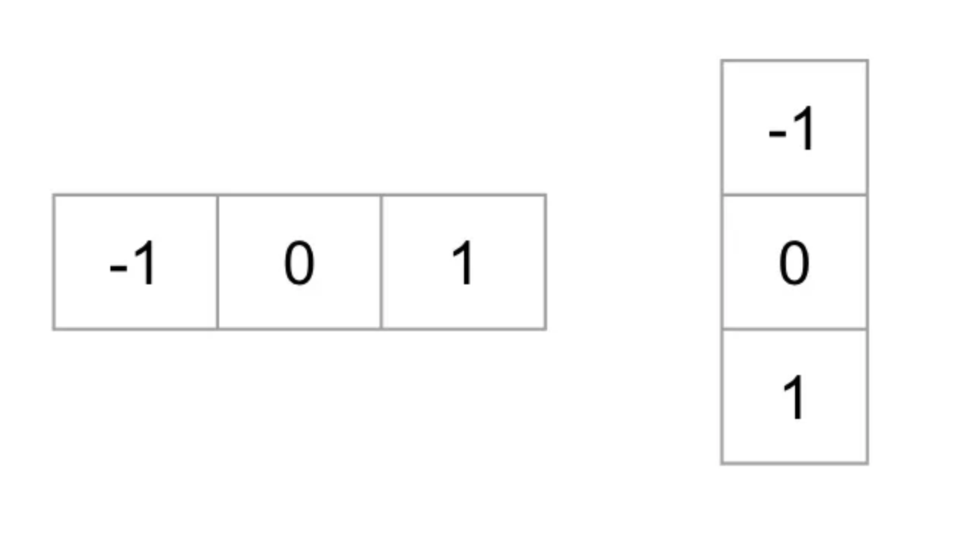
Calculate The Gradient
To calculate a HOG descriptor, we need to first calculate the horizontal and vertical gradients; after all, we want to calculate the histogram of gradients. This is easily achieved by filtering the image with the following kernels.

Slide 9
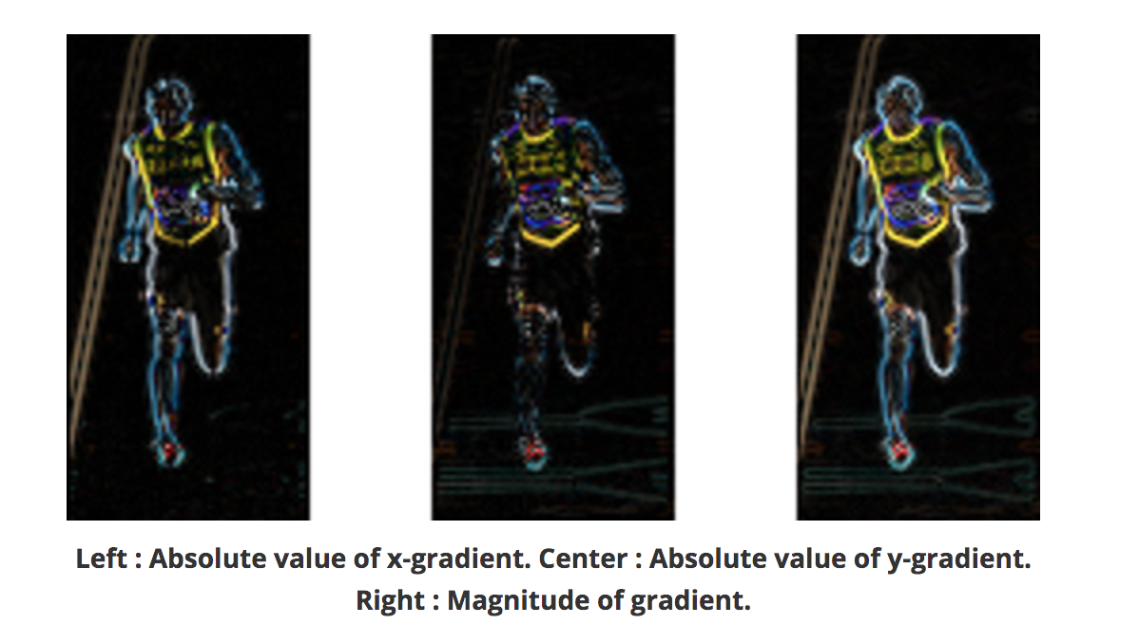
Calculate the Gradient Images
Notice, the x-gradient fires on vertical lines and the y-gradient fires on horizontal lines. The magnitude of gradient fires where ever there is a sharp change in intensity. None of them fire when the region is smooth

Slide 10
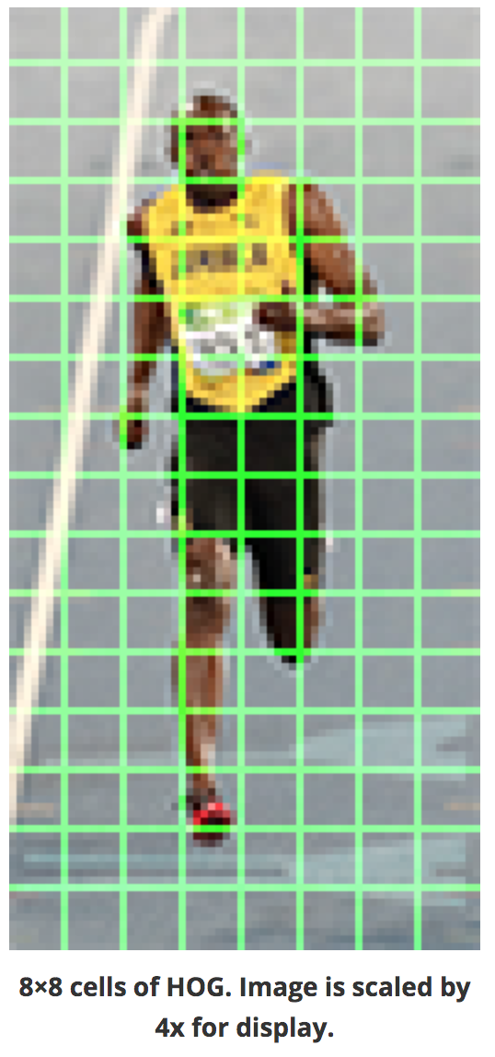
Calculate the Hisogram of Gradient Images
In this step, the image is divided into 8×8 cells and a histogram of gradients is calculated for each 8×8 cells
An 8×8 image patch contains 8x8x3 = 192 pixel values
The gradient of this patch contains 2 values ( magnitude and direction ) per pixel which adds up to 8x8x2 = 128 numbers
these 128 numbers are represented using a 9-bin histogram which can be stored as an array of 9 numbers.

Slide 11
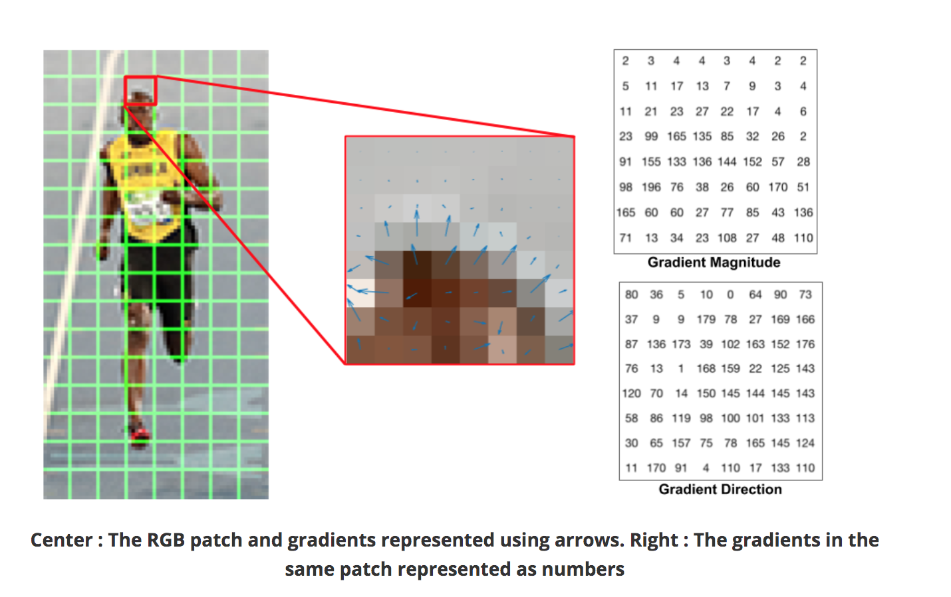
Calculate the Hisogram of Gradient Images
Let us look at one 8×8 patch in the image and see how the gradients look.
The next step is to create a histogram of gradients in these 8×8 cells. The histogram contains 9 bins corresponding to angles 0, 20, 40 … 160.

Slide 12
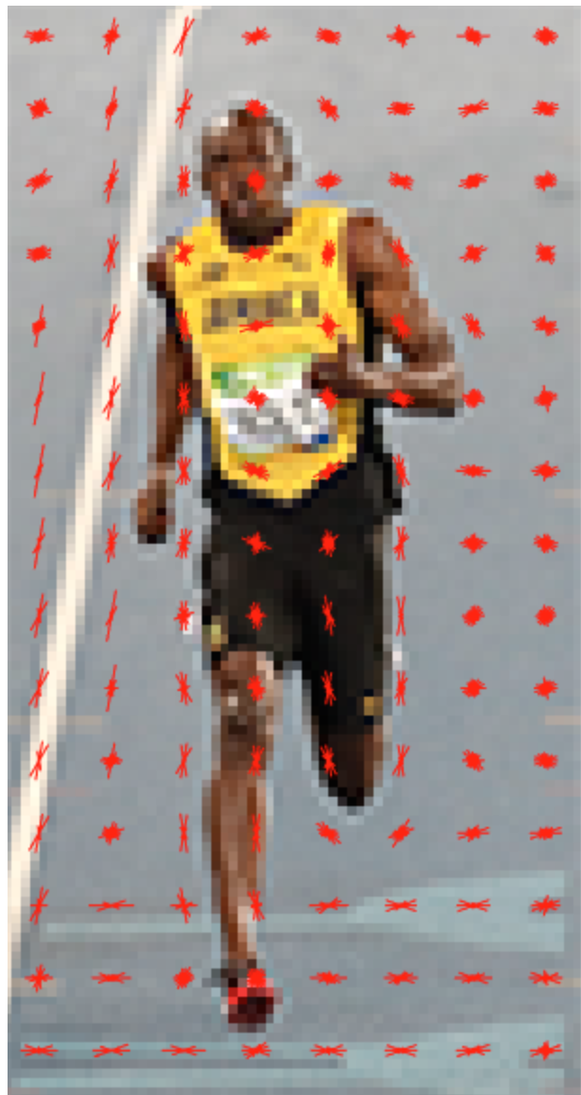
Visualizing the HOG Features
You will notice that dominant direction of the histogram captures the shape of the person, especially around the torso and legs.

Slide 13
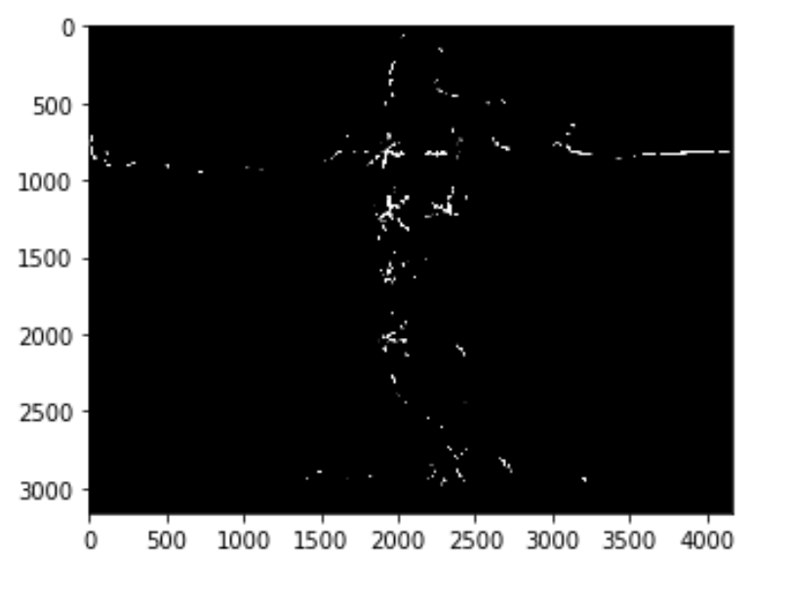
Visualizing the HOG Features
HOG Features of Dog
from skimage import data, exposure
fd, roi_hog_fd = hog(im_th, orientations=9, pixels_per_cell=(14, 14),
cells_per_block=(1, 1), visualize=True)
# Rescale histogram for better display
hog_image_rescaled = exposure.rescale_intensity(roi_hog_fd, in_range=(0, 10))
plt.imshow(hog_image_rescaled, cmap=plt.cm.gray)
plt.show()

Slide 14
HoG Feature Extraction
This all sounds good, but what is “useful” and what is “extraneous” ? To define “useful”, we need to know what is it “useful” for ? Clearly, the feature vector is not useful for the purpose of viewing the image. But, it is very useful for tasks like image recognition and object detection. The feature vector produced by these algorithms when fed into an image classification algorithms like Support Vector Machine (SVM) produce good results.

